Slide 1
High Performance Computing
Introduction to Parallel Processing.pptx

Slide 2
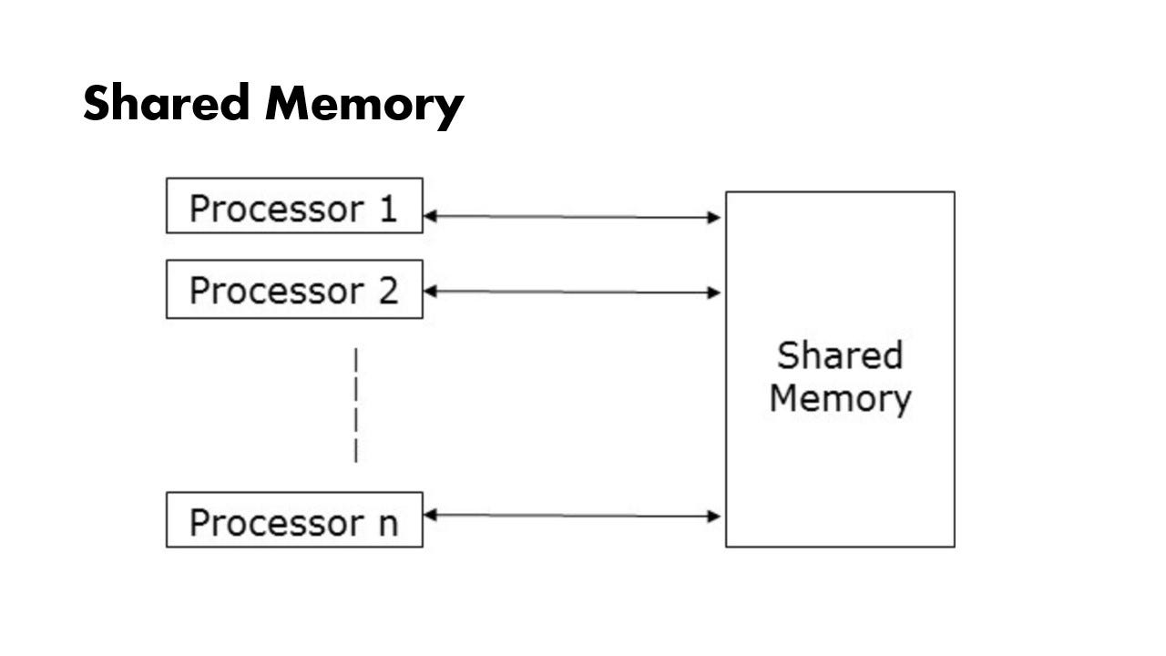
Parallel Programming Models: A Taxonomy
This presentation explores fundamental parallel programming models, crucial for efficient utilization of multi-core processors and distributed systems. We'll examine their characteristics and suitability for different applications.

Slide 3
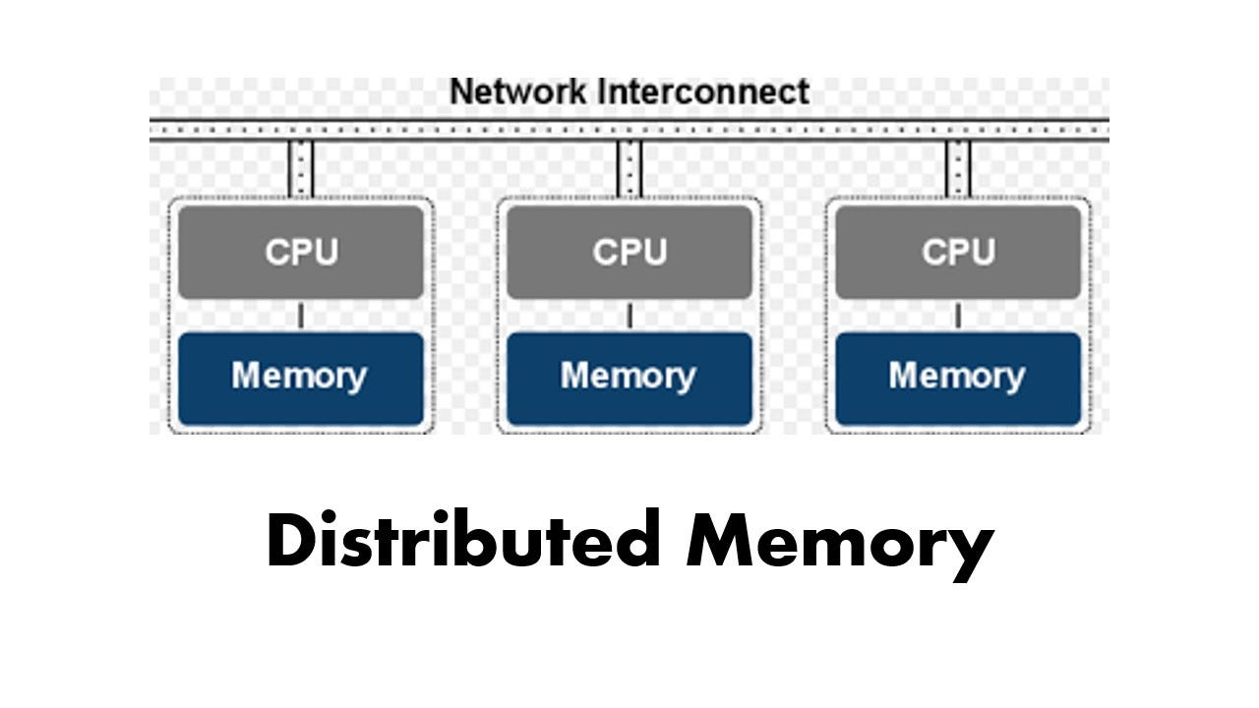
Shared Memory Parallelism
Multiple threads/processes share the same address space, simplifying data sharing but requiring careful synchronization (mutexes, semaphores) to avoid race conditions. Examples: OpenMP, Pthreads. Scenario: A team analyzing a large dataset concurrently, coordinating updates to shared results.

Slide 4
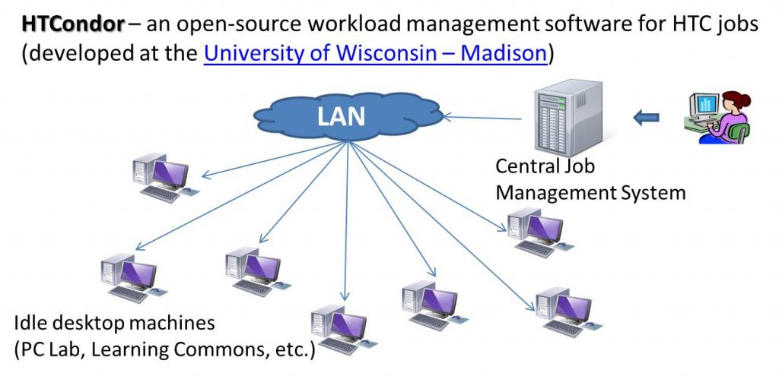
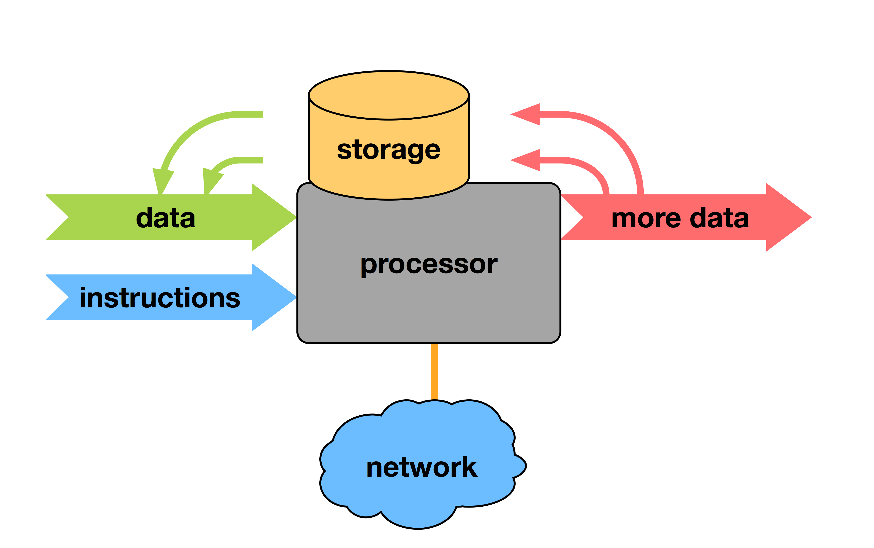
Distributed Memory Parallelism
Multiple processors with their own local memory communicate via message passing (MPI). Scales well to large systems but necessitates explicit communication strategies. Scenario: Simulating a large-scale weather model, with each processor handling a geographic area and exchanging data with neighbors.

Slide 5
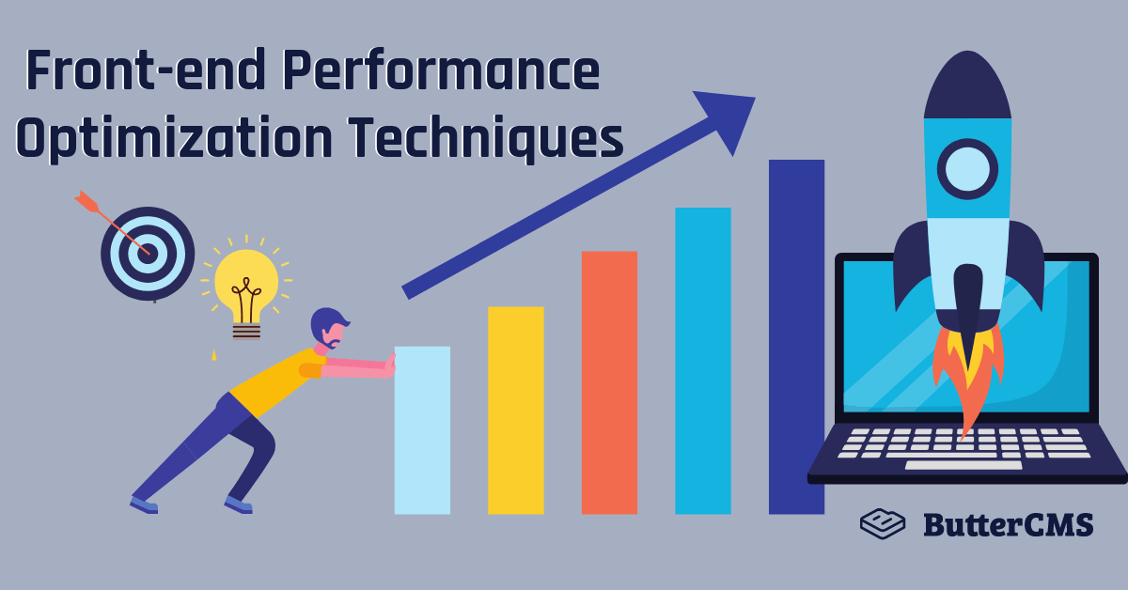
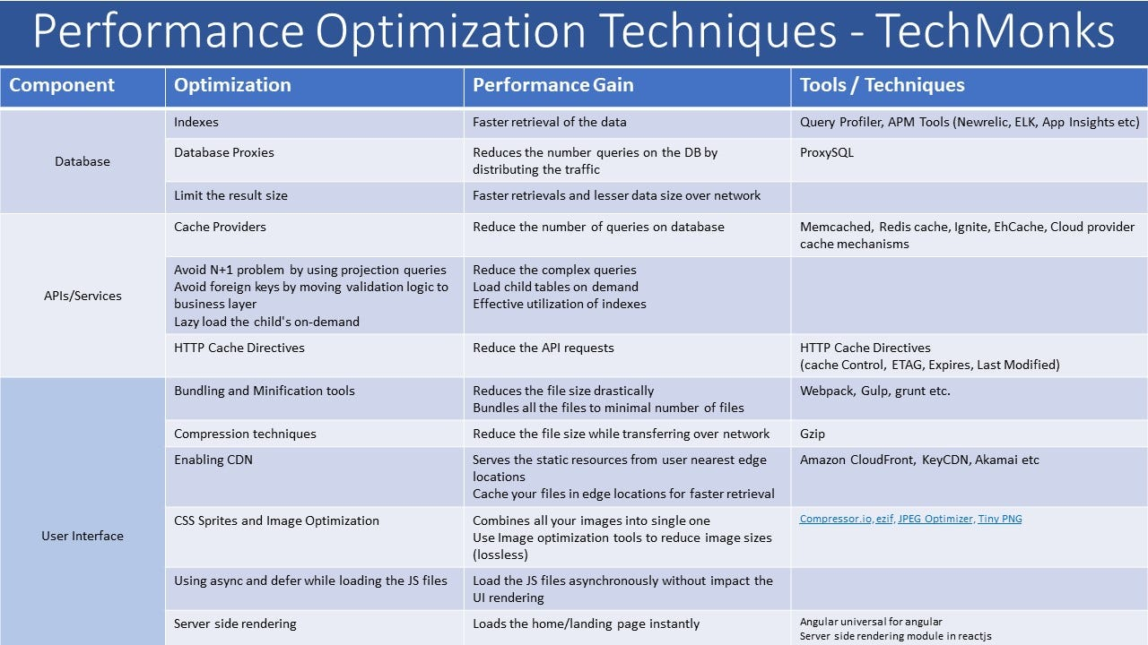
Data Parallelism
Distribute data across processors, applying the same operation to each subset concurrently. Ideal for independent operations on large datasets. Examples: MapReduce, Spark. Scenario: Processing a massive image dataset for object recognition, with each processor handling a subset of images.

Slide 6
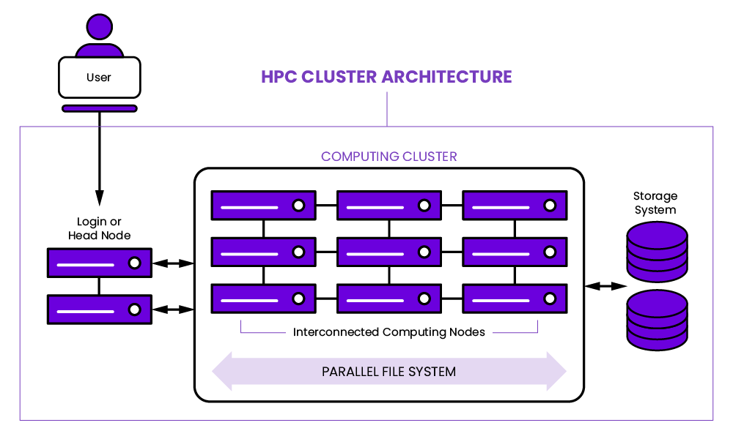
Task Parallelism
Divide a program into independent tasks executed concurrently. Suitable for applications with naturally independent sub-problems. Scenario: Rendering a 3D scene, with each object rendered as an independent task.

Slide 7
Hybrid Parallelism
Combines shared and distributed memory techniques, leveraging the strengths of both. Used in large-scale systems with shared memory nodes and distributed memory clusters. Scenario: A large scientific simulation on a cluster of multi-core nodes, using shared memory within nodes and distributed memory between nodes.

Slide 8
Shared Memory Parallelism: Core Concepts
Multiple processing units (cores, threads) concurrently access and manipulate a shared memory pool. Eliminates data transfer overhead but necessitates synchronization to prevent race conditions.

Slide 9
Synchronization Mechanisms
Mutexes: Ensure exclusive access to critical sections. Semaphores: Manage access to resources. Barriers: Ensure all threads reach a point before proceeding. These prevent race conditions and data corruption.

Slide 10
OpenMP: A Practical Approach
Widely used API for shared memory parallelism. Provides compiler directives for easy parallelization, managing thread creation, synchronization, and load balancing.

Slide 11
Real-World Applications of Shared Memory Parallelism
Image processing
Scientific computing
Financial modeling
Machine learning (training models on large datasets)

Slide 12
Advantages & Disadvantages of Shared Memory Parallelism
Advantages: Faster execution with significant data sharing, easier programming, efficient data access. Disadvantages: Scalability limited by the number of cores, requires careful synchronization, potential memory contention.

Slide 13
Distributed Memory Parallelism: Fundamentals
Multiple processors, each with private memory, communicate via message passing. Suitable for problems decomposable into independent sub-problems. Key concepts: message passing, process management, network topology.

Slide 14
Message Passing Interface (MPI)
Standard for message-passing in distributed memory systems. Provides functions for sending/receiving data, managing communication, and handling various communication patterns.

Slide 15
Communication and Synchronization in MPI
Efficient communication (point-to-point, collective) and synchronization are crucial for performance. Synchronization mechanisms ensure coordinated actions, preventing race conditions and data inconsistencies.

Slide 16
Real-world Applications of Distributed Memory Parallelism
Weather forecasting
Scientific simulations (molecular dynamics, fluid dynamics)
Big data analytics
Financial modeling

Slide 17
Advantages & Disadvantages of Distributed Memory Parallelism
Advantages: Scalability, fault tolerance, suitability for problems with independent sub-problems. Disadvantages: Programming complexity, potential communication bottlenecks, need for high-bandwidth interconnects.

Slide 18
High-Throughput Computing (HTC): Maximizing Task Completion
Focuses on maximizing the number of tasks completed within a given timeframe, rather than minimizing the runtime of individual tasks. Ideal for large datasets or many independent jobs.

Slide 19
Key Characteristics of HTC
Large-scale data processing, task parallelization, fault tolerance, efficient job scheduling. Employs many relatively modest computing resources.

Slide 20
Applications of HTC
Genomics
Drug discovery
Financial modeling
Climate modeling
Machine Learning

Slide 21
HTC vs. HPC
HTC: Maximizes task completion; HPC: Minimizes runtime of individual tasks. Often used together: HPC for computationally intensive steps, HTC for overall project management and data processing.

Slide 22
Essential Components of an HTC System
Resource management system (HTCondor, Slurm), distributed storage, network infrastructure, monitoring and logging.

Slide 23
Performance Optimization in Parallel Processing: Key Strategies
Techniques to improve the speed, scalability, and resource utilization of parallel applications.

Slide 24
Amdahl's Law: Understanding Limitations
Speedup is limited by the sequential portion of the program. Focus on minimizing the sequential fraction.

Slide 25
Load Balancing: Distributing the Workload
Evenly distribute workload to prevent some processors finishing early while others lag. Techniques: static and dynamic load balancing.

Slide 26
Data Locality and Communication Optimization
Minimize data movement between processors. Strategies: data partitioning, caching, efficient communication libraries (MPI).

Slide 27
Parallel Programming Model Optimization
Choose the appropriate model (MPI, OpenMP) and optimize code within that model. Use compiler directives, optimize data structures, and choose appropriate algorithms.

Slide 28
Profiling and Performance Analysis
Profiling tools (gprof, Valgrind, Intel VTune) identify performance bottlenecks, allowing for targeted optimizations.

Slide 29
High-Performance Computing (HPC) Environments: Architecture and Software
Exploration of HPC architectures, key components, and challenges in effective utilization.

Slide 30
HPC Architectures: Shared, Distributed, and Hybrid
Shared-memory: multiple processors share memory; Distributed-memory: multiple nodes with own memory (MPI for communication); Hybrid: combination of both.

Slide 31
Software and Tools in HPC
Job schedulers (Slurm, PBS), parallel programming models (MPI, OpenMP), debugging tools, performance analysis tools, optimized libraries (BLAS, LAPACK).

Slide 32
Programming for HPC: Challenges and Considerations
Data partitioning, communication overhead, load balancing, fault tolerance, parallel programming paradigms (data and task parallelism).

Slide 33
Challenges in HPC
Resource management, debugging parallel programs, ensuring data consistency, avoiding race conditions, fault tolerance.

